Slide 1
Poster Judging - Plus
By: Team 9 (Lorena Burrell, Farhana Chadni, Kevin Johnson, Josh Pauldin, Alex Siegel)

Slide 2
Outline
Description and purpose
Targeted users
Technical platforms
UML use case diagrams
UML sequence diagram
Wireframes
Process flow
HTML demo
…

Slide 3
Description and Purpose of Software System
Description
Purpose
A web application that allows contestants and judges to create an account (using GSU email, name, and a password), and allows them to login (using email and password) after the account is created.
Allows contestants to upload an image of a poster along with it’s info (title, group member emails, category, and description), and view feedback once judged.
Allows judges to view a list of posters to judge, and then view one, judge one, and submit the feedback. The cycle can repeat until no posters are left.
Once judging is finished, an overall winner is calculated.
Give the contestants in GSU’s Poster contest a way to upload their poster information and a picture of their poster online, and view a judge’s feedback on it
Give the judges in GSU’s Poster contest an online way to judge and review posters assigned to them
Automate activities like assigning candidates to a judge, calculating overall scores, and determining a winner.
Make judging unbiased

Slide 4
Targeted Users
Judges
Contestants
Professors at Georgia State University who want to judge posters in the Poster Contest
Students at Georgia State University who want to participate in the Poster Contest

Slide 5
Technical Platforms
Frontend
Middle Layer
Backend
HTML
CSS
JavaScript
Python
Flask
SQLite DB

Slide 6
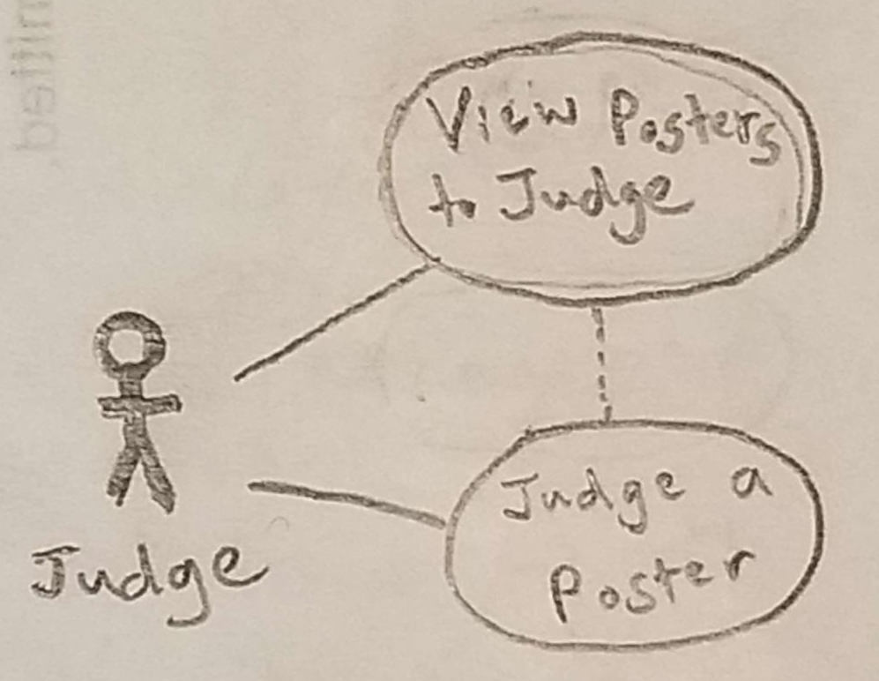
UML Use Case: Judge

Slide 7
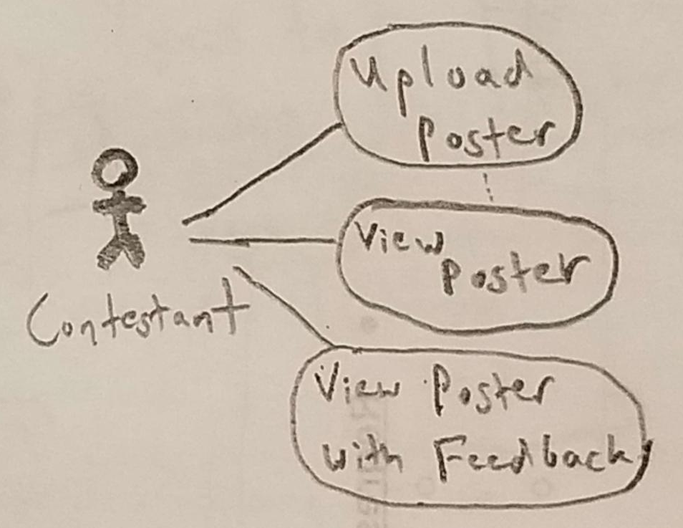
UML Use Case: Contestant

Slide 8
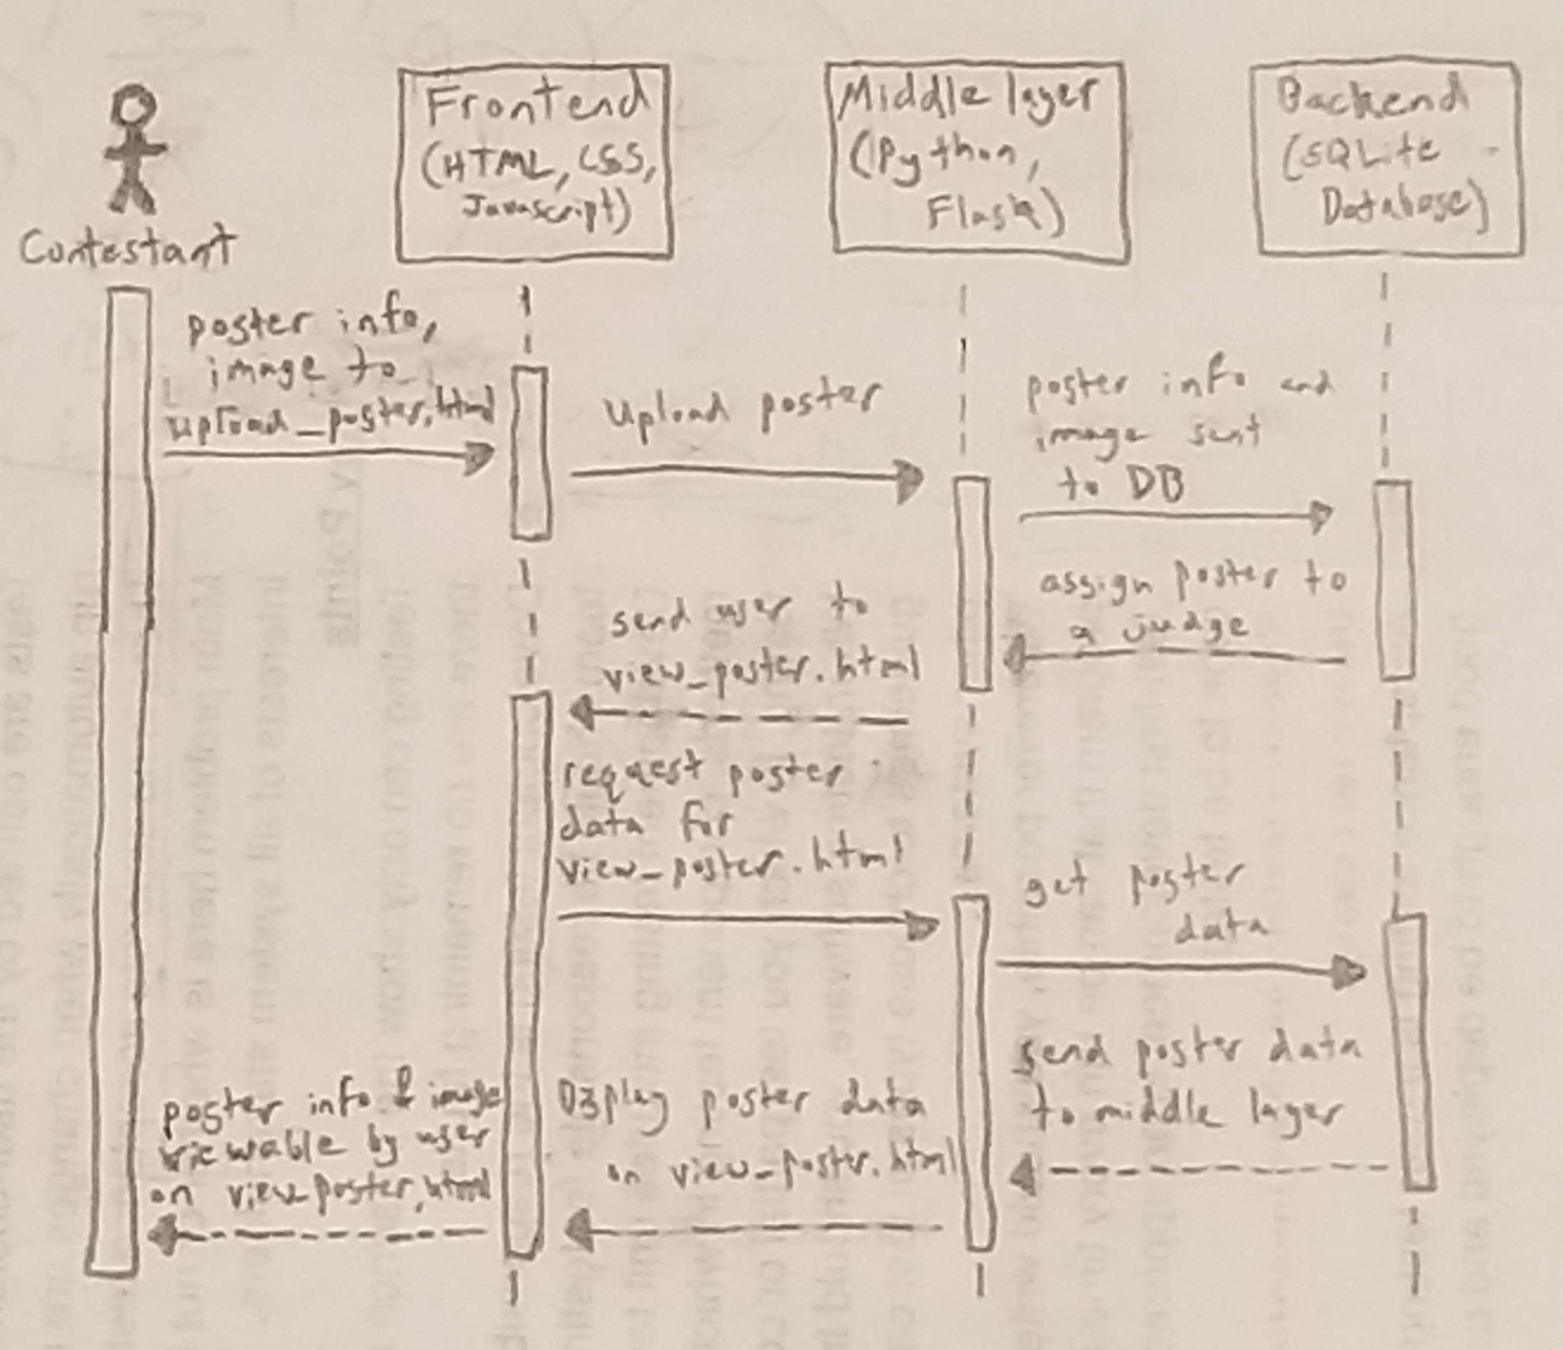
UML Sequence Diagram:

Slide 9
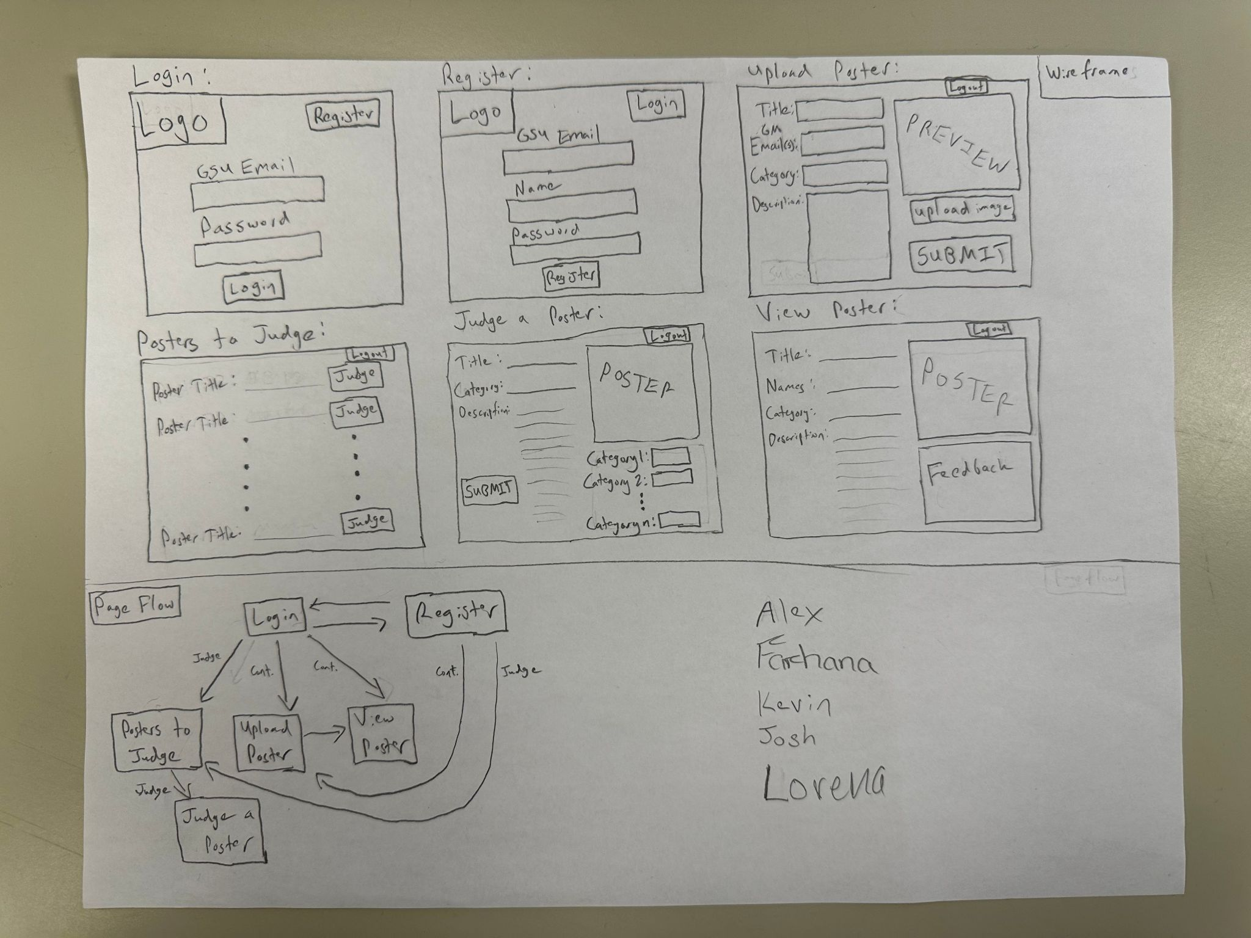
Wireframes

Slide 10
Process Flow

Slide 11
HTML Demo

